Slide 1
Preventing school suspension Research findings
Sarah Martin-Denham @blogsenco
16th September 2021
Research links (sure.sunderland.ac.uk)

Slide 2
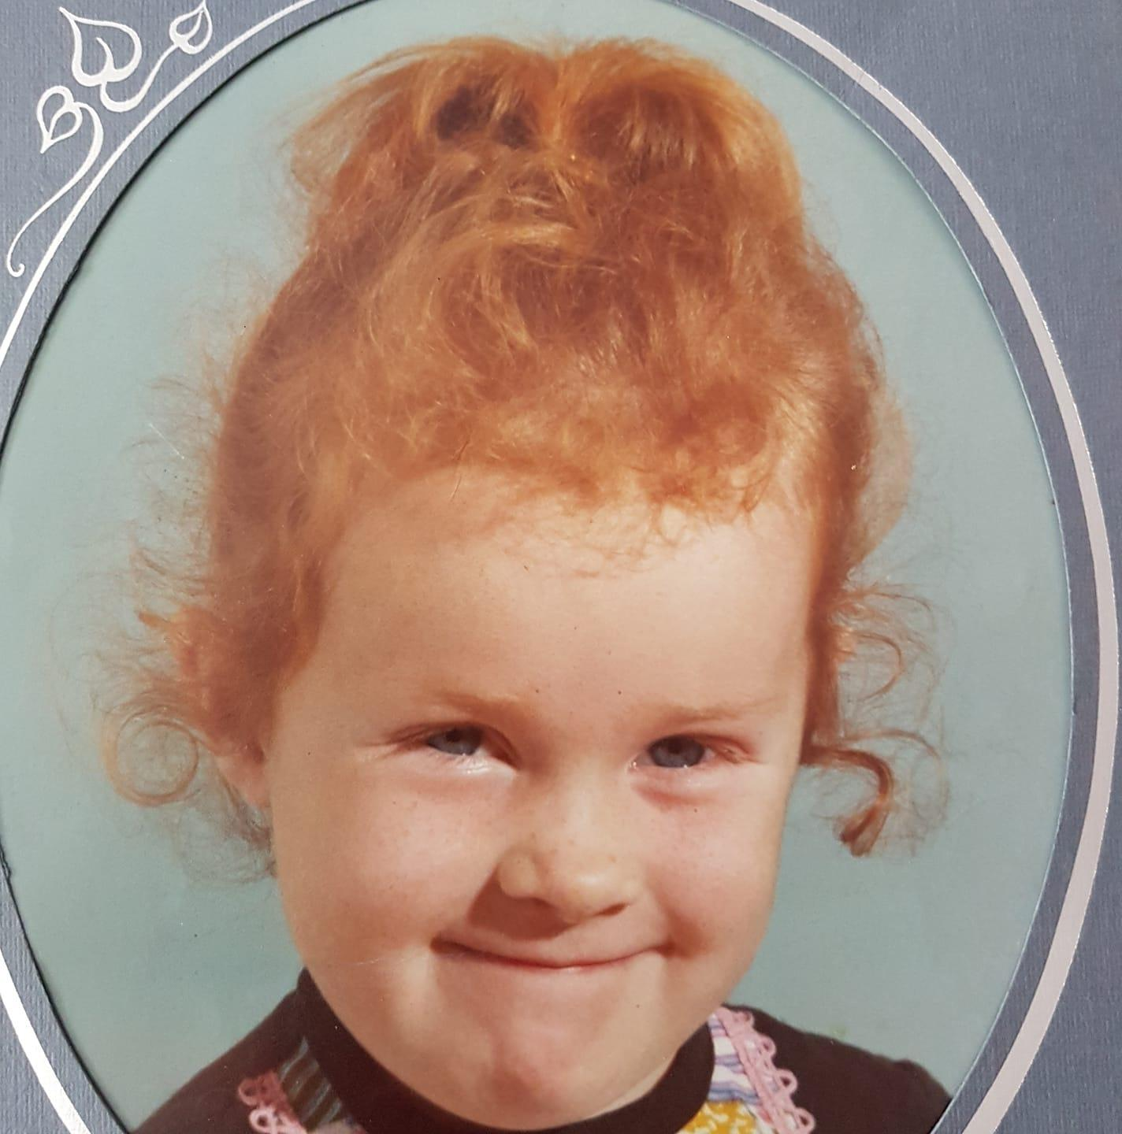
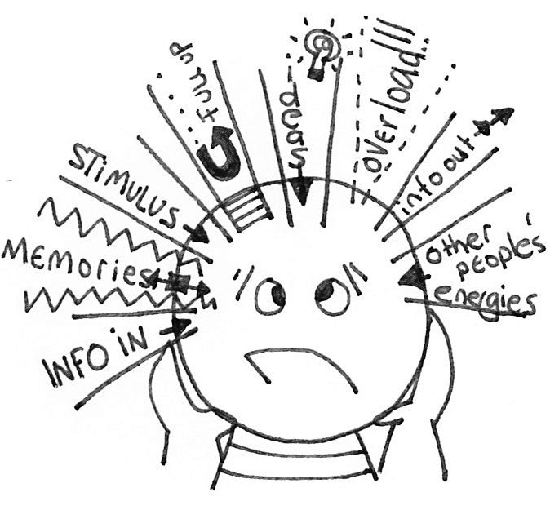
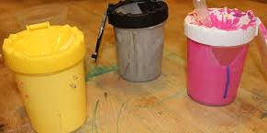
+ + + + =
An arsonist is someone who has been convicted of the crime of arson, the term fire setting refers to behaviour characterised by the deliberate setting of fires, which has not led to a conviction (Alexander et al., 2015).
Contributing factors to fire setting (according to literature)
Depression, conduct disorder (CD), oppositional defiant disorder (ODD) and attentional deficit hyperactivity disorder (ADHD) (Becker et al., 2004).
Boredom, lack of parental supervision, low fear of fire, lack of fire safety knowledge and access to matches contribute to a firesetting episode (Lambie & Randell, 2011).

Slide 3
Types of school exclusion
Fixed period (suspended) – They can be removed up to 45 days in one school year.
Permanent (expelled) – Not allowed to return to the school, unless the exclusion is overturned on appeal.

Slide 4
Martin-Denham, S. (2020) The enablers and barriers to mainstream schooling: The voices of children
excluded from school, their caregivers, and professionals. Sunderland: University of Sunderland.
Sample: Participant overview
Group | Count | Sample
Children | 55 | 32%
KS1 | 20 | 11%
KS2/3 | 15 | 9%
KS4 | 20 | 11%
Caregivers | 41 | 24%
KS1 | 4 | 2%
KS2/3 | 16 | 9%
KS4 | 21 | 12%
Professionals | 78 | 45%
Nursery headteachers | 4 | 2%
Primary headteachers | 28 | 16%
Secondary headteachers | 9 | 5%
Specialist headteachers | 4 | 2%
ARP/AP headteachers | 10 | 6%
SENCO | 14 | 8%
Health and support | 9 | 5%
Total | 174
174 children, caregivers and professionals interviewed.
In addition, there were three advisory groups, 12 children, five professionals from health/support services and five education professionals who came to the University.

Slide 5
Proportion of headteachers in Sunderland schools interviewed
Type of School | Total in Sunderland | Sample Candidates | % Sampled
Mainstream Nursery | 8 | 4 | 50%
Mainstream Primary | 62 | 28 | 45%
Mainstream Secondary | 18 | 10 | 56%
Special School | 7 | 4 | 57%
Alternative Provision | 6 | 4 | 67%
Additional Resourced Provision | 15 | 3 | 20%
Total | 116 | 53 | 46%

Slide 6
Children: Challenges in mainstream school¹ (KS1)
The environment
The curriculum
‘I find it difficult to do maths'
‘I hate the mud’
‘I find it difficult because the work is too hard’
‘I find it hard when I am doing PE, sometimes punch people because everyone is shouting and chanting it makes me angry’
‘I need help in the playground because me and a child had a problem’
‘Noise made me feel pressure, I was upset and angry’
‘Sometimes I do scream that’s how I stop hurting people’

Slide 7
Children: Challenges in mainstream school¹ (KS2-3)
‘There were too many people and I needed so much help, I wasn’t getting any at all, I didn’t cope well’
‘I say can you help with this? The person says no I’ll come back to you, but they came back at the end of the lesson or at the end of the task’
‘There were too many people and I needed so much help. I wasn’t getting any, at all. I didn’t cope well. So, I would kick off a lot
‘It stresses me out. I feel I start to go crazy. When I’m angry that I feel like I’m going crazy’
‘The fire alarms there are so high pitched. That’s why I’m glad I’ve left'
‘They would have my arms like ‘that’ and someone was on the other side, pulling my arms’
‘Every time the times tables get quick… I used to get one out of ten and others get ten out of ten, but they were too big and there was a timer, you had to read how many you got in front of the class’
‘They didn’t have time to listen’
‘It is hard for the teachers to get round’

Slide 8
Children: Challenges in mainstream school¹ (KS4)
Lack of in class support
The environment/approaches
‘They didn’t support me, so I was going home crying… because they weren’t helping me through anything, they just told me to get on with it’
‘The fact is when I asked for help, they wouldn’t give it to me, they would just say I will come back to you’
‘Thirty children and only one member of staff to support them’
‘They can’t get round a class of thirty, just helping one child all the time’
‘He would make us line up on the morning break and dinner to make sure we were all checked’
‘We would be outside for twenty minutes to make sure we had our coats and correct uniform'

Slide 9
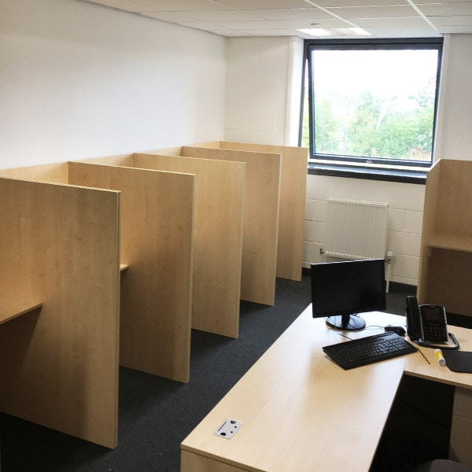
Length of time in isolation¹
From DfE Behaviour and Discipline (DfE, 2016)
“Schools can adopt a policy which allows disruptive pupils to be placed in an area away from other pupils for a limited period”
“It is for individual schools to decide how long a pupil should be kept in seclusion or isolation, and for the staff member in charge to determine what pupils may and may not do during the time they are there”
'Emotional or psychological abuse is any type of abuse that involves the continual emotional mistreatment of a child. Emotional abuse can involve deliberately trying to scare, humiliate, isolate or ignore a child' (NSPCC, 2020).

Slide 10
Impact of isolation (children)¹
Impact on mental/physical health
Impact on learning
‘I used to pull my hair out, scratch my face. I couldn’t cope with it at all. The teachers used to sit there and watch me cry’
'They used to call it ‘the bridge’ because it made you want to just jump off a bridge’
‘It was depressing I felt alone'
‘I ended up quite lonely’
‘I didn’t like it, it made me feel sick, they just told me to do my work’
‘You weren’t allowed to cough or breathe loud’
‘You weren’t allowed to turn around or make any noises’
‘It made me feel dizzy’.
‘I didn’t do anything. So that is why I came to this school knowing nothing (alternative provision), I was so behind on everything after two and a half years in isolation’
‘I couldn’t even read or write properly, because they used to kick me out of lessons’
‘They just told you to sit down and get on with your work, no teaching’
‘Not taught just worksheets, just had to figure that shit out for myself, but that’s life isn’t it’
‘If I asked them but they wouldn’t help go through a question. They would do an example and then say they wouldn’t help anymore’

Slide 11
Children: Keeping us in mainstream¹
What helps?
KS1
KS2/3
'Shorter school days'
'Nurture group'
'Cuddling'
'Having time to talk'
'Help me make good choices'
'To bring in teddies and fidget cubes'
'If someone had explained the work. I would have done it. I'd have understood it'
'If they had given you a list, like a power point. It tells you; you need to this, then this and this'
'I need more staff helping, explaining things, maths was the only lesson I could get because I have dyslexia. They weren't helping with that'
'Maybe not restrain me as much'
'The more they shout, the more I shout'
'Football calms me down when I am with my friends'

Slide 12
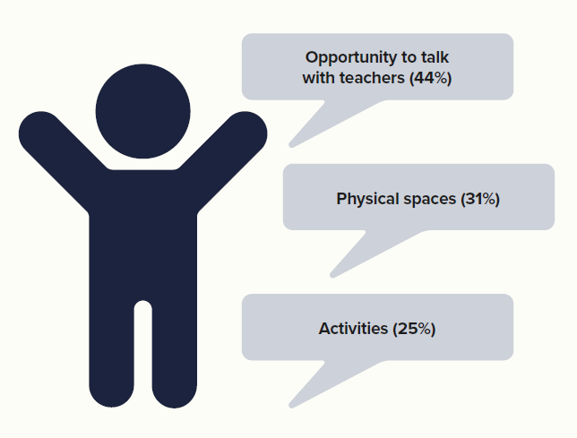
Advisory group of children: Alternatives to isolation booths
12 children aged 8-16 with permanent school exclusions
All 12 children agreed isolation booths do not modify or improve behaviour and in most cases, makes it worse.
One child argued that some type of isolation system was needed because disruptive children should not be allowed in classrooms; the other children did not respond or agree with this view.
The outcome of the discussion was that the children voted unanimously that the main change needed to improve mainstream education was the removal of all isolation booths, and this forms the basis of recommendation 1 in this report.

Slide 13
Martin-Denham, S. (2022) The road to school exclusion: An interpretative phenomenological analysis of interviews with parents of children with autism in the UK. [Accepted: Support for Learning].
Of the forty-one caregivers who took part in the original study, five met the criteria for this article:
They had a child with a diagnosis of autism
They had a child who had received fixed-period and/or permanent exclusions

Slide 14
Viv
1 | Parent requests SaLT referral | 13 | Child discloses suicidal feelings to caregivers | 25 | Child placed on school report | 37 | School declines EHCP Assessment request
2 | SaLT Finds no concerns | 14 | Caregivers tell child about ASD diagnosis | 26 | Multiple fixed-period exclusions | 38 | School move
3 | School reports disruptive behaviour to parent | 15 | Child assaults a pupil in school | 27 | Child physically assaulted by another child, resulting in dislocated finger | 39 | Child bullied for being different
4 | Parent requests consultant referral, consultant, no concerns | 16 | First fixed-period exclusion | 28 | Mother reports incident to school, dismissed as accident | 40 | Mother requested managed move, managed move agreed to PRU
5 | Consultant discharges with no concerns | 17 | School refers child to CAHMS | 29 | Caregivers contact police about disability discrimination | 41 | School move to PRU
6 | Mother arranges referral to consultant, child diagnosed with ASD | 18 | Multiple fixed-period exclusions | 30 | Police interviews result in no further action | 42 | Bespoke curriculum implemented, vocational college training agreed
7 | Caregivers request assessment for an EHCP | 19 | Multiple fixed-period exclusions | 31 | Mother requested a managed move/EHCP assessment by school | 43 | Child passing exams
8 | School decline caregiver request for EHCP | 20 | CAMHS suspect ADHD and refer to CYPS | 32 | School declines Managed Move and EHCP needs assessment | 44 | School 3 submits EHC assessment request
9 | Educational psychologist assessment arranged by school | 21 | Mutiple fixed-period exclusions | 33 | Mother prescribed beta blockers for anxiety | 45 | EHCP needs assessment rejected
10 | Educational psychologist finds no learning difficulties | 22 | CYPS diagnose ADHD, child medicated for ADHD | 34 | Child assaults pupil | 46 | EHCP assessment refusal appealed, school 3 provide supporting evidence
11 | SENCO requests assessment for EHCP | 23 | Caregivers report bullying to school | 35 | Permanent school exclusion | 47 | EHCP assessment decision overturned, EHCP granted
12 | LA decline assessment for EHCP | 24 | School removes breaktimes but re-instates after parental complaint | 36 | Caregivers re-request referral for EHCP assessment by school

Slide 15
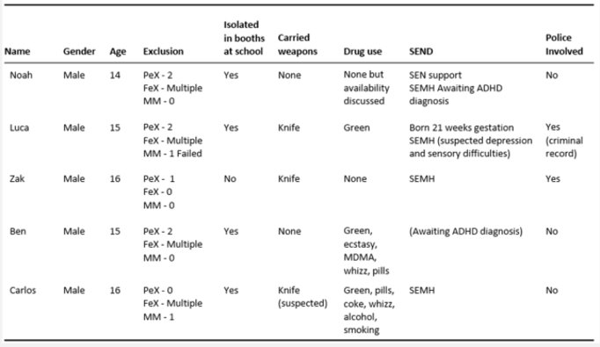
³Martin-Denham, S. (2021) School exclusion, substance misuse and use of weapons: An interpretative phenomenological analysis of interviews with children. Support for Learning, 36(4) [Accepted].
Five children​
• Drivers, supply and implications of drug use​
• Drivers and implications of carrying a knife​
• Solutions to reducing fixed-period and permanent exclusion​

Slide 16
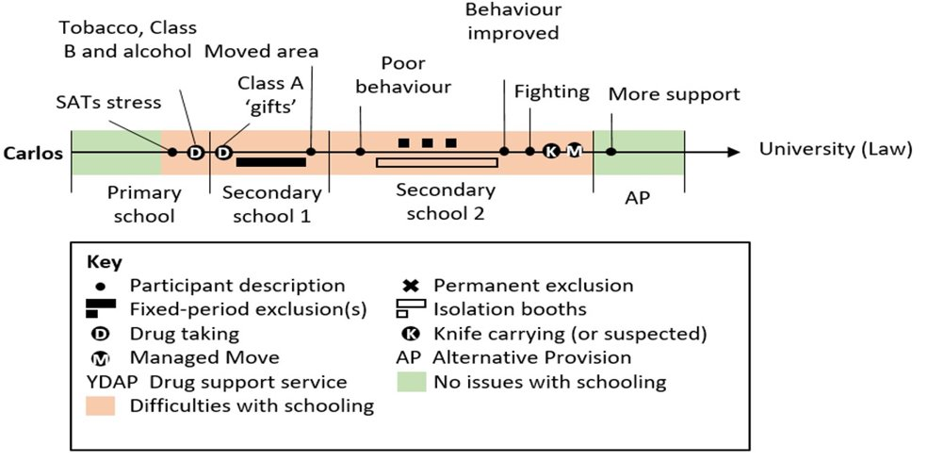
Year​ | Overview​
Y6 | SATS stress, academic focus​, smoking, weed, alcohol, drugs because older kids take them (Y10s-11s)
Y7 ​ | Unable to cope with teachers shouting, isolation, not taught
Y8-Y10 | Frequent isolation, no learning
Y10 | Accused of having a knife (never found)
Y10​ | School 3, 10 points only allowed 6, failed. Banter over a girl and phone in class​
Y10-11​ | Drug awareness, AP, engaging​
‘Younger people would get involved because the older people were taking it. The younger people would start hanging around with them and then they would take it. That happened to me. I was in Year 7 and I was messing up. So, I was ‘cool’, so I started hanging around with Year 10s and 11s. That was how I got into it and that is how most people get into it’.

Slide 17
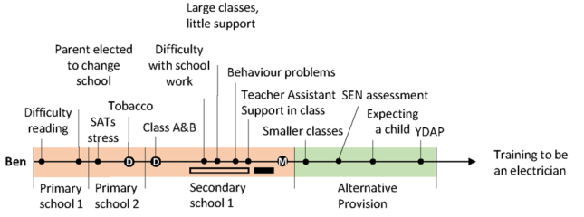
Year​ | Overview​
Y-5-6 | Taken out of class, unable to read, SATS stress
Y7- 11 | Unable to access curriculum, unidentified SEN
Y7-10 | Frequently in isolation
Y9 | Support for behaviour
Y11 | Becoming a father, came of drugs, focused on exam success, engaging in AP
’I got took out class to do my work. Because I couldn’t read’ (y6)
‘They got this lass in to help with my behaviour. Why give me that in Year 9? Or Year 8? When I needed it in Year 7’

Slide 18
Drivers for drug use
Children are consuming drugs mainly to aid concentration in school, to self-medicate to reduce sanctions imposed on them by teachers⁵ and to relax
School curriculum pressures, too much focus on attainment at the cost of mental health
Lack of both early and prompt identification and support for children with SEND/SEMH from schools and complex referral processes
Further research needed on school exclusion and drug use

Slide 19
Key messages
Behaviour sanctions in mainstream schools such as detention and isolation booths do not often improve behaviour but make it worse
Too many caregivers are told they would not meet the threshold for an EHC needs assessment
Schools are taking advantage of the loose terminology in statutory guidance
Children are consuming drugs before school to cope with their inability to access the learning, to aid their concentration and to medicate themselves to reduce the likelihood of being sanctioned by teachers
Prompt identification and support for children is important to support learning and subsequent mental health needs

Slide 20
Now...
2nd ed.
3 journal articles in press on school exclusion

Slide 21
Publication list for the presentation (access at sure.sunderland.ac.uk)
¹Martin-Denham, S. (2020) The enablers and barriers to mainstream schooling: The voices of children
excluded from school, their caregivers, and professionals. Sunderland: University of Sunderland.
²Martin-Denham, S. (2022) The road to school exclusion: An interpretative phenomenological analysis of
interviews with parents of children with autism in the UK. [Accepted: Support for Learning].
³Martin-Denham, S. (2021) School exclusion, substance misuse and use of weapons: An interpretative
phenomenological analysis of interviews with children. Support for Learning, 36(4) [Accepted].
Martin-Denham, S. and Donaghue, J. (2020a) What is the prevalence of primary and secondary types of
Special Educational Needs (SEN) in the City of Sunderland? A national comparative analysis of school census data.
Sunderland: University of Sunderland.
Martin-Denham and Donaghue (2020b) A review of school census data on fixed-term and permanent
school exclusions in the City of Sunderland. Sunderland: University of Sunderland.

